Slide 1
Introduction to pester
Starting to trust your code

Slide 2




Stephane van gulick
Cloud & Datacenter Management MVP (Powershell)
My Open Sourced projects
https://github.com/Stephanevg/
Co-founder of the FRPSUG
https://frpsug.github.io/
Founder of BPUG
http://www.bpug.ch/

Slide 3
What is a test?
A test is a block of code that:
Allows to validate a given situation / state
Is not something that has to be automatic
Allows to build trust
Basically returns: $True / $False

Slide 4
Testing frameworks
Every language has it's testing framework(s)
Ruby: Rspec,Shoulda,Test::Unit
Java: Junit, Selenium
Csharp: Nunit,Xunit
PowerShell: Pester,PSUnit

Slide 5
Why Test?
Why not?

Slide 6
Quality
Test every (edge) case of a function
Avoid regression (Introducing bugs while adding features)
Ensures the cohesion of a system

Slide 7
TRUSt
You can trust the code to work as expected
Trusting that your last modification didn't break anything
Trust the code that comes from another repo, is bug free (…)

Slide 8
Pester – The code
Syntax + Use cases

Slide 9
Installation
Current latest version: v4.4.2
Shiped in Windows OS :
Windows 10
Windows Server 2016 (v3.3.4)
Install-module Pester
Download latest release from https://github.com/pester/Pester/releases

Slide 10
Demo 1: our first test
Part 1

Slide 11
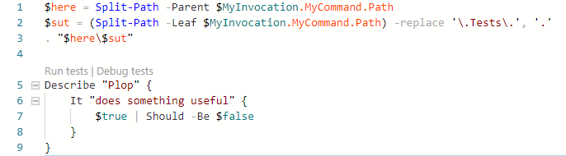
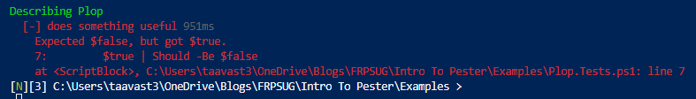
Base test (Using F5)

Slide 12
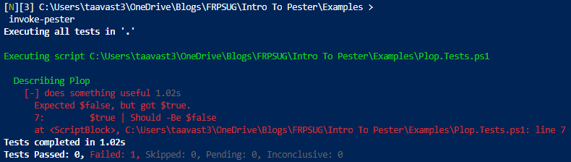
base test (Invoke-Pester)

Slide 13
Base keywords
Describe
(Context)
It
Should

Slide 14
Demo2: Syntax explained
Part 2

Slide 15
Assertions
Should
Be
Not Be
BeExactly
Exist
https://github.com/pester/Pester/wiki/Should

Slide 16
Demo 3
Exercice 1

Slide 17
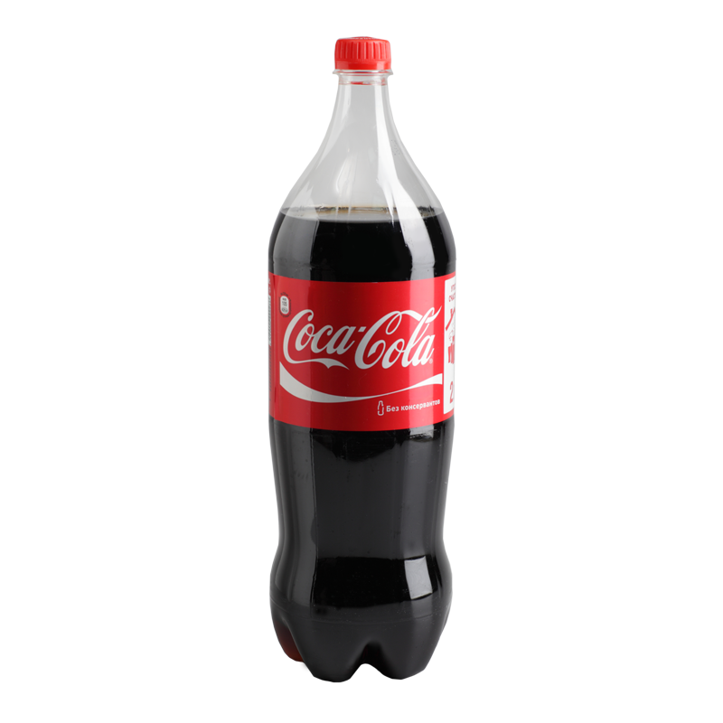
Pair programming: Coca Cola Style (!!)

Slide 18
Coca cola
Coca
Cola
#Create a test for a function called: Export-BiosData that exports BIOS information In the following formats:
#CSV -> $Home\BiosData.csv
#JSON -> $Home\BiosData.Json
#the file must be located at: $Home\BiosData.Json or $Home\BiosData.csv
#Create a function that export Bios data to either:
#CSV File -> $Home\BiosData.csv
#or
#Json File -> $Home\BiosData.Json

Slide 19
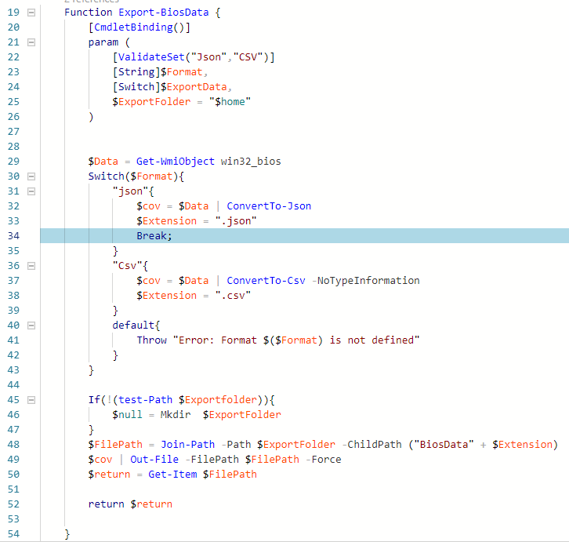
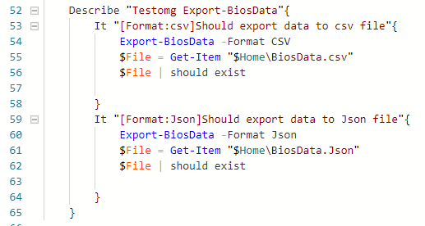
(One possible) Solution
COCA
COLA

Slide 20
Discussion

Slide 21
Advanced Pester concepts
TestDrive

Slide 22
Demo 4: Test drive
Part 4

Slide 23

Pair programming: Tom & Jerry style(!!)

Slide 24
Tom & Jerry
Tom
Jerry
Write a test that:
When parameter –ExportFolder $Path is called, it should export the JSON / CSV data to that $Path folder
File should not pollute user's machine
Hint: Use a test drive
Add parameter –ExportFolder to Export-BiosData
Parameter should accept a string
Cannot be null

Slide 25
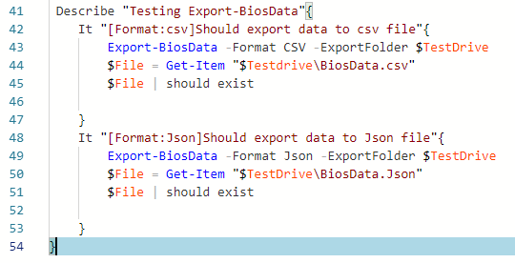
(one possible) solution
tom
Jerry

Slide 26
Demo 5: Test drive applied

Slide 27
Testdrive takeaways
Variable $Testdrive
Drive TestDrive:
Scope -> Describe blocks

Slide 28
Caffe?
Une pause bien Méritée ;)

Slide 29
Advanced Pester concepts
Mocking

Slide 30
Discussion
What is mocking?

Slide 31
Demo 6: Mocking
Part 6

Slide 32
Discussion
Where do you think you could use mocks?

Slide 33
Advanced Pester concepts
Passthru

Slide 34
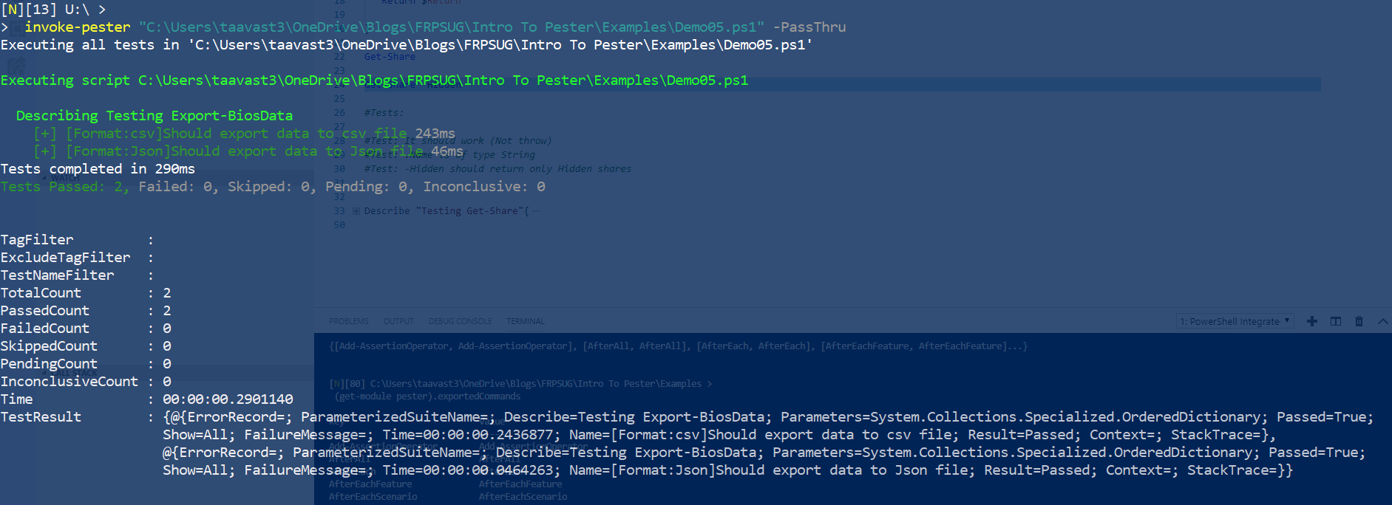
Returning objects

Slide 35
Demo 7: Passthru
Part 7

Slide 36
Discussion
Where do you think you could use Passthru?

Slide 37
Advanced Pester concepts
Show

Slide 38
Demo 8: Show
Part 8

Slide 39
Discussion
Where do you think you could use Show?

Slide 40
Advanced Pester concepts: exporting Tests
NunitXML

Slide 41
NunitXML
Exporting Tests results to NunitXML allow to persists tests results over time.
NunitXML is a standard Test format
It can be read by most standard CI platforms (Jenkins, Appveyor,Travis,Azure Devops, Gitlab(?))

Slide 42
Demo 9: Nunit
Part 9

Slide 43

Pair programming: Laurel & Hardy Style!

Slide 44
Laurel & Hardy: Printers
Laurel
Hardy
Create Pester test 1 (Test must fail)
Should contain printers (Location)
Create Function 2 (Test must pass)
Hide output, export NunitXML
Tip: Win32_Printer
Create function 1 (Test must pass)
Return a list of attached printers
Create Pester test 2 (Test must fail)
Add ability to list network printers only
Analyze pester tests based on NunitXML (From powershell)

Slide 45
Discussion
What do exporting test to nunitxml file allows?
What are the drawback with working with Nunit XML files?

Slide 46
Advanced Pester concepts: POSHNunitXML
NunitXML

Slide 47
POSHNUNINTXML
https://github.com/Stephanevg/PoshNunitXML
Open Source Module I wrote to convert NunitXML back into an usable object
Is class based
Requires Powershell version 5.1

Slide 48
Honorable mentions
InModuleScope
BeforeEach
AfterEach
TestCases
Tag

